Slide 1
Observer Design Pattern

Slide 2
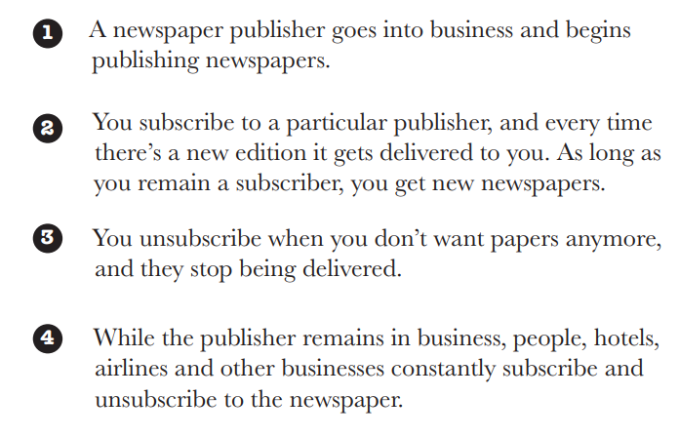
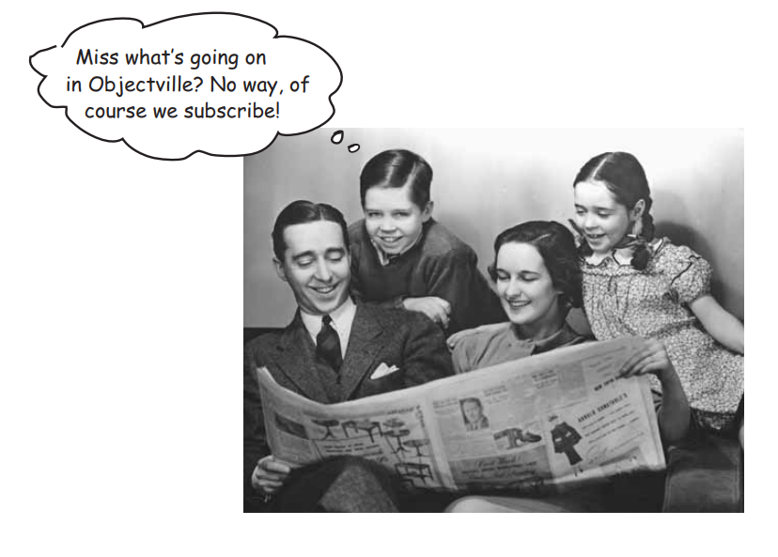
How Newspaper subscription works:

Slide 3
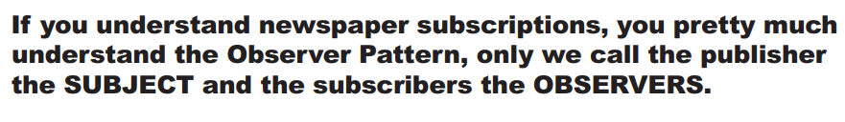





iLearn
CS 2310
Subject
Observers

Slide 4
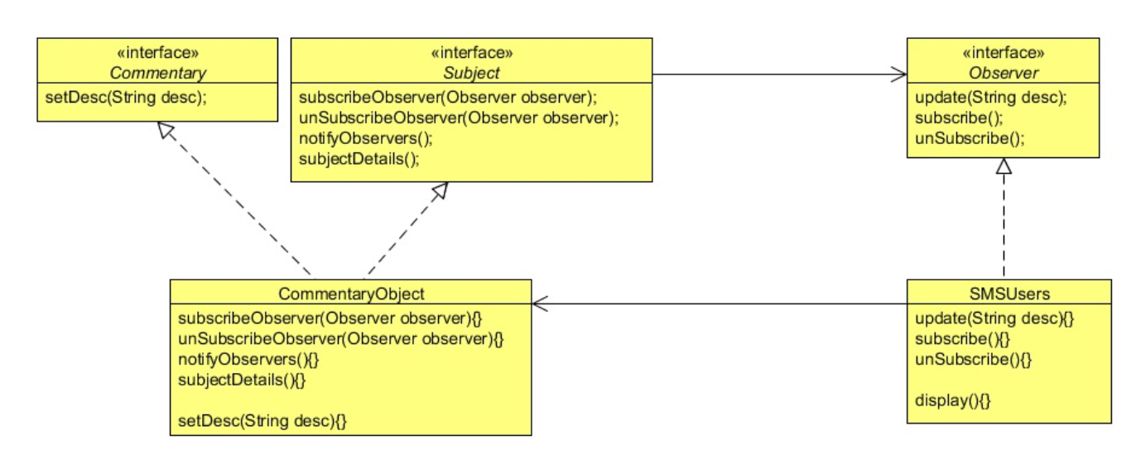

Slide 5
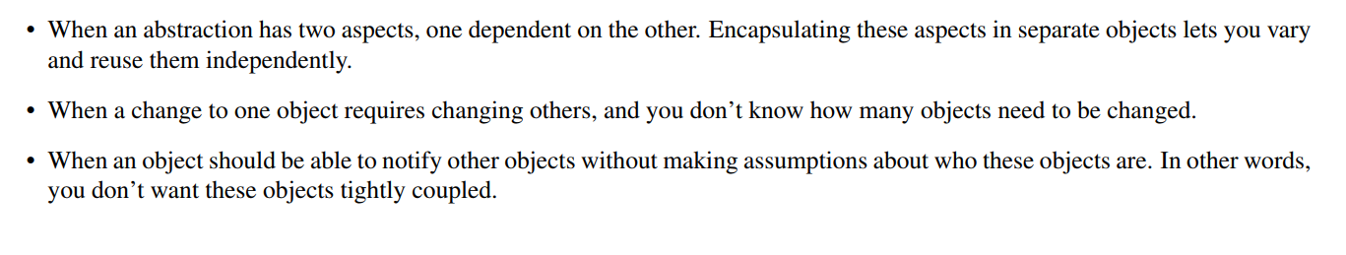
When to use Observer Pattern

